Slide 1

ASSIGNMENT ROUND

Slide 2
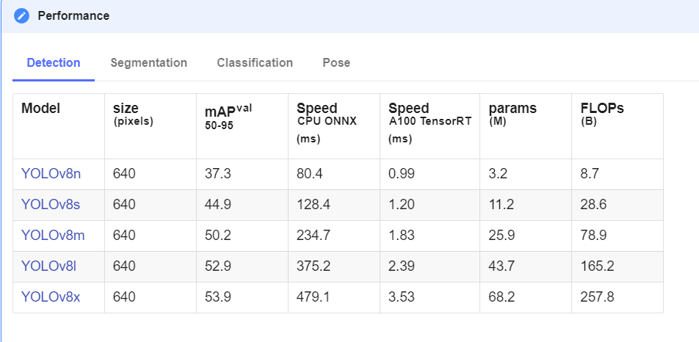
Choice of model

Slide 3
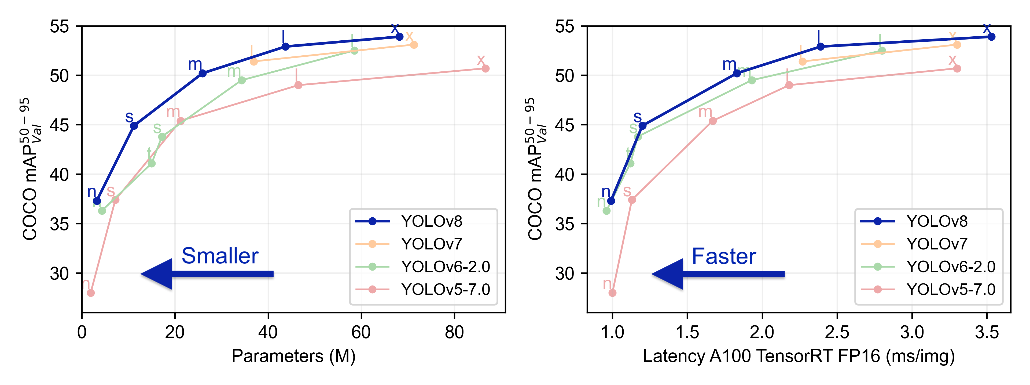
WHY YOLOv8?
YOLOv8 adopts an anchor-free split ultralytics head, which contributes to better accuracy and a more efficient detection process compared to anchor-based approaches.
YOLOv8 offers a range of pre-trained models to cater object tracking task provides a good trade off between speed and accuracy.

Slide 4
Methods Adopted which failed
Yolov8 with Deepsort was adopted initially to begin with. Because of the disadvantages this method was dropped. The major disadvantage found was the inability of model to perform when the person enters towards east of the video. Due to two entrance paths followed by people, this proved to be giving less accuracy.

Slide 5
Current Approach
The current approach has Yolov8 tracking coupled with a custom counter method. In this two polygons are drawn in the frame i.e. area 1 which shows the entrance and area 2 which shows the exit. If a person is detected in any of the area, then their id and position is stored in a dictionary. Then the details are checked with next area, if the same id is present in next area as well then counter is updated.

Slide 6
Advantages and Drawbacks
Advantages
This method was able to detect the person inspite of the number of entrance or exits.
Drawbacks
FPS is not up to mark.
When there is overlap between two people, model tends to confuse sometimes.

Slide 7
FPS OPTIMIZATION
To optimize the FPS, later on instead of pytorch model, onnx model was used.
ONNX runtime : 8.09 FPS
PyTorch : 3.61FPS
The above results are based on CPU.
Model quantization approach can be followed.
Improvement in hardware can be done. Like using GPU/TPU.

Slide 8
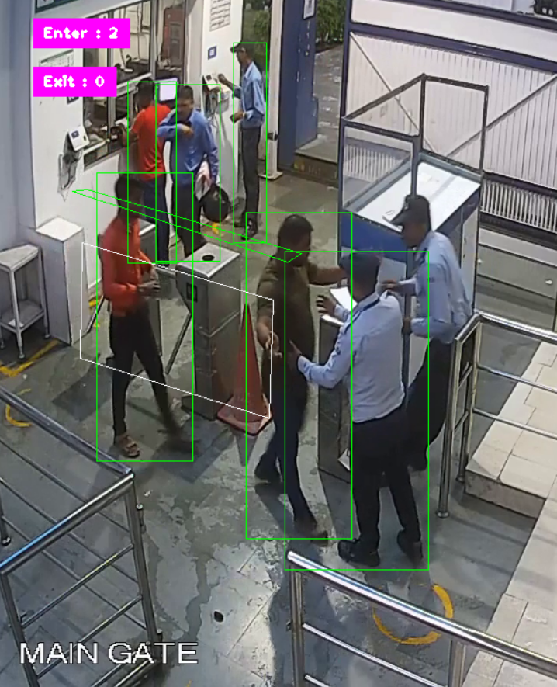
RESULT

